Slide 1
ENGR 12
Dr. Mandala
Notes:
Down

Slide 2
In your teams
Write m-script that asks user to enter any whole number between 1 and 1000, and find whether the number is prime or not. Repeat as many times as users wants.
Use the inputdlg to accept user input
Print the result including the number the user entered.
EX: ‘You entered: 13. This is a PRIME number.’
EX: ‘You entered: 945. This is NOT a prime.’

Slide 3
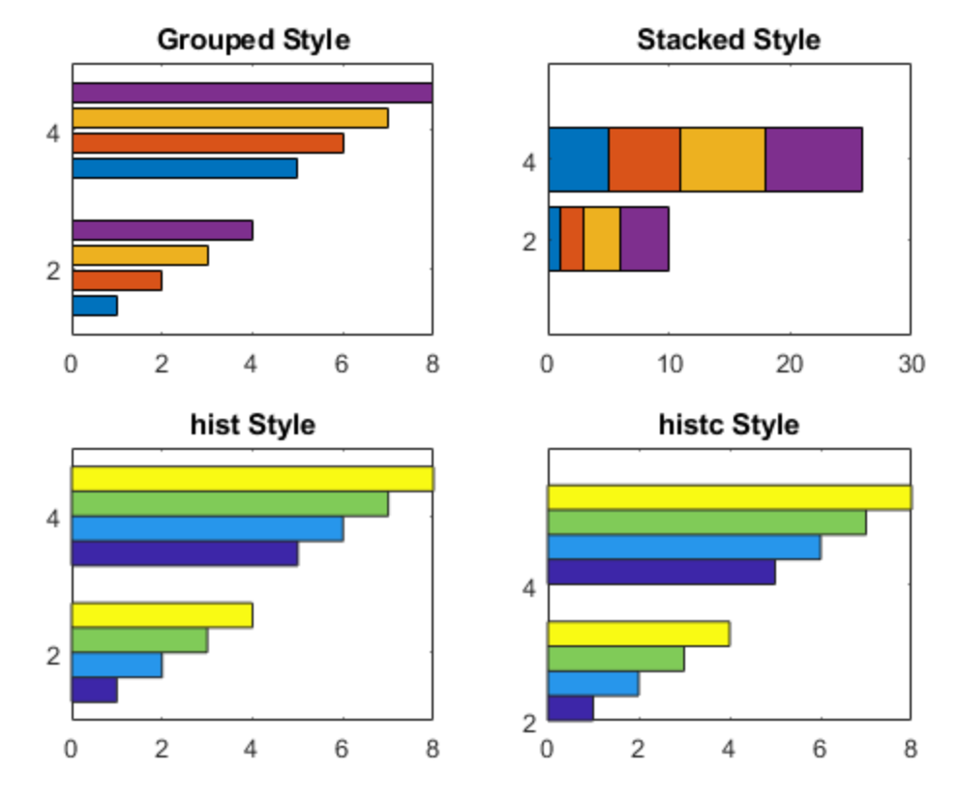
How would I plot?

Slide 4
Generating multiple plots
subplots
The subplot command allows a given figure window in MATLAB to be broken into a rectangular array of plots, each addressed with standard plot commands
The command subplot(m,n,p) or subplot(mnp) splits the figure window into an array of plots m-rows by n-columns, and addresses the pth subplot (the subplot index p counts from left to right beginning with the upper left plot and ending with the lower right plot)
NOTE
The subplot command does not plot data; it only creates axes in the figure window. You still need to use the plot command (or other commands that generate a plot), to graph data in a subplot

Slide 5
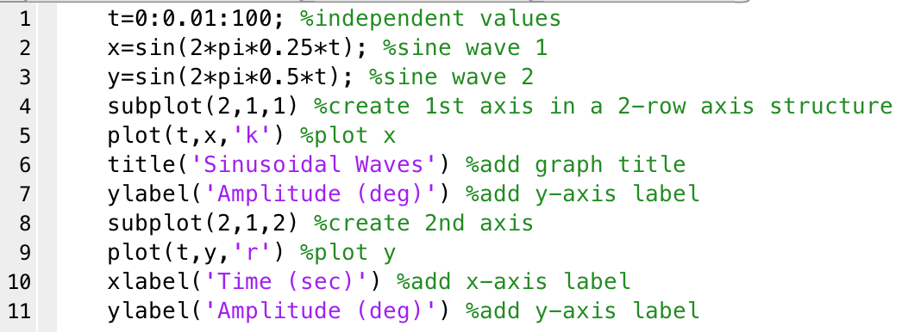
Sample Subplot code

Slide 6
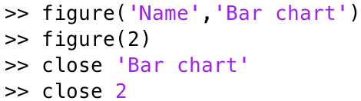

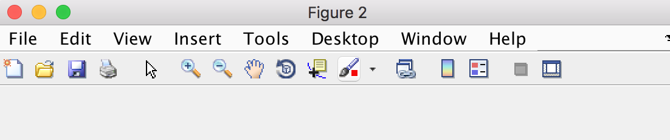
Creating and closing fig windows

Slide 7
How can Matlab derive Regression line?
Use polyfit command
coeff = polyfit(x,y,n)
polyfit finds the coeff (e.g., a1 and a0) of a polynomial f(x) of degree n that fits the data y via least squares method; x and y are data pairs, and n represents polynomial degree.
coeff = polyfit(x,y,1)
Polynomial :
f(x)=anx^{n}+an-1x^{n-1}+…+a2x²+a1x¹+a0x⁰, where x⁰=1, an: are the polynomial coefficients, and n: polynomial degree (value of the highest exponent is the degree of the polynomial).
For example, linear: f(x)=a1x+a0, quadratic: f(x)=a2x²+a1x+a0, cubic: f(x)=a3x³+a2x²+a1x+a0
Notes:
X & Y are data points

Slide 8
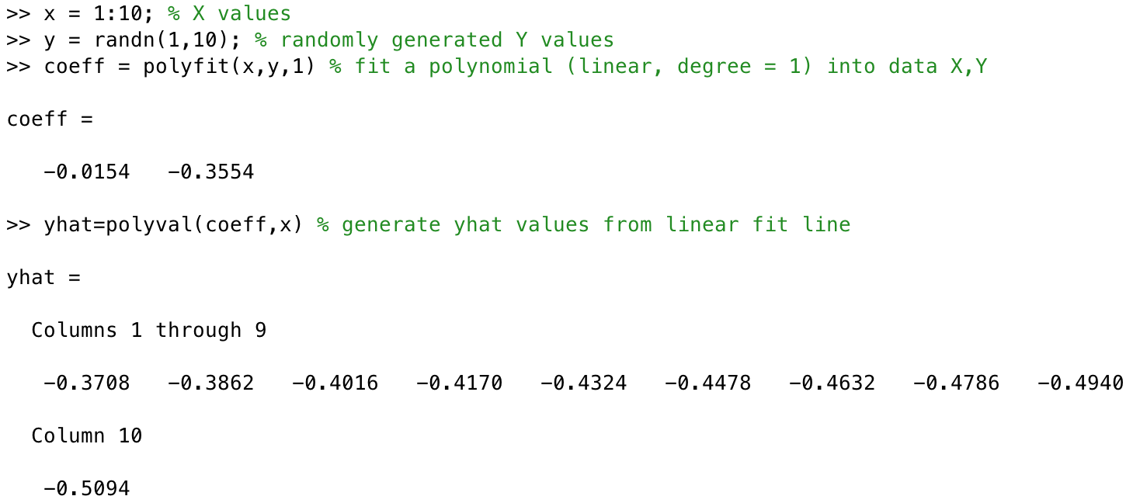
How can we calculate f(X)
Use polyval command to determine values if yHat=f(x)
Note: yHat is used instead of y to distinguish between the two data sets
Notes:
If x is an array, polyval calculates yhat for each element of the array and stores it in a new yhat array. In example above, x is an array (1:10);
To calculate yhat at a single value, simply replace x with the value. E.g. yhat=polyval(coeff, 12);

Slide 9


Curve fitting: exponential function
Exponential data of form
Transform into linear equation by taking log of both sides:
This equation looks a lot like f(x)=a1x+a0, with a1 representing the slope, log(a0) representing the intercept. Also, note that instead of y we have log(y)
The plot of this equation where x is in rectangular coordinates but y is in logarithmic form (i.e., log(y)), is called a semi-log plot
In MATLAB, you can use the semilogy command to generate this plot: semilogy(x,y)
Notes:
X=[1 2 3 4 5 6 7]
Y=[1.1 3.0 8.0 21.8 59.4 161.4 438.6]

Slide 10

Curve fitting: power function
Exponential data of form
Transform into linear equation by taking log of both sides:
This equation looks a lot like f(x)=a1x+a0, with a1 representing the slope, log(a0) representing the intercept. Also, note that instead of y we have log(y) and instead of x we have log(x)
The plot of this equation where x and y are in logarithmic form (i.e., log(x) and log(y)), is called a log-log plot
In MATLAB, you can use the loglog command to generate this plot: loglog(x,y)
Notes:
X=[1 2 3 4 5 6 7]
Y=[2 9.2 22.4 42.2 69.0 103.0 144.6]

Slide 11
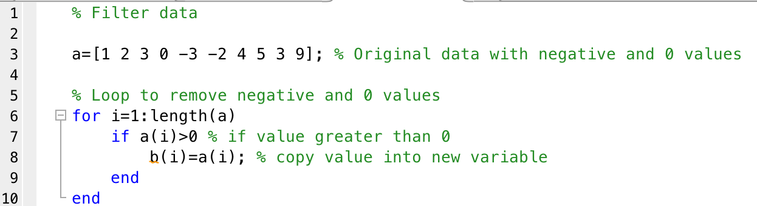
Filtering data
How would you filter bad data (negative or zeros in case of log transformation)?
Strategy:
Loop through data array and create a new array copy which excludes bad data (whatever condition you pick for the if statement).

Slide 12
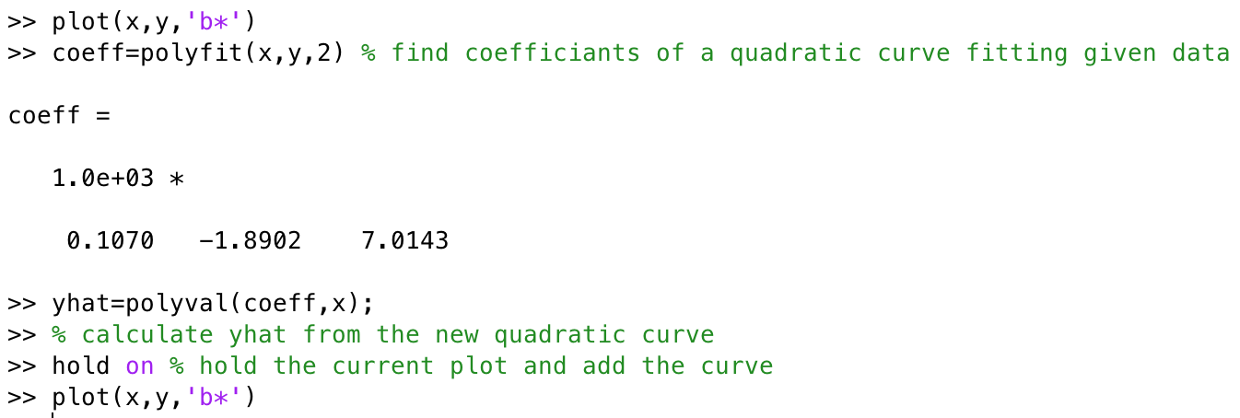
Polynomial curve fit
If x and y data pair, does not fall on a straight line, how can we find a curve that does fit the data?
Use polyfit with n>1
Notes:
Check out the next slide for the plots

Slide 13
Try example
Download data from courseweb: ‘curvefit.dat’
Load data into matlab
Plot the data on x-y plot with triangle data points only
Overlay the plot with a polynomial of maximum possible degree to exactly fit the data.
Note: If you have N data points, the polynomial function that will fit these data points exactly has an order N-1.
A polynomial of 5th degree will exactly fit 6 data points.

Slide 14
Tweak the plot…
Include several data points to smooth out the polynomial function fit to the data
Use linspace or :
Linspace(1,10,100) or 1:0.1:10
Create a new x dataset, call it x_new
Plot new figure with x-y data and add new polynomial fit over x_new

Slide 15
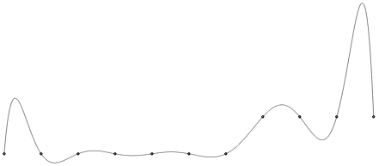

Cubic spline
Polynomial curves of high degree (n > 1) have a disadvantage. Requirements placed on one stretch of such a curve can have a very strong effect some distance away…
In contrast, if you use cubic spline curves through the same data points, you end up with a different fit. Notice how the curve follows the data points much more closely…

Slide 16
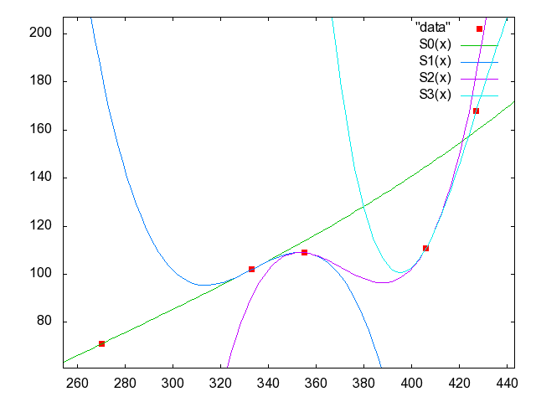
What are splines?
Splines are smooth piecewise polynomials: several connected functions describing a set of data points
Cubic splines are 3rd order polynomials
Notes:
Figure above has four functions, we need five (see the two points on the right are not connected).

Slide 17
How to matlab cubic splines?
Use spline command to generate coefficients
Equivalent to polyfit command
Sample: spline_ceoff=spline(x,y)
Use ppval command to generate estimated/predicted y-values from given x-data
Equivalent to polyval command
Sample: spline_y=ppval(spline_coeff,x)
Note: you will need to create more data points on x to show a smooth spline.

Slide 18
Sample cubic spline fit
Assume that you are given x and y data pairs. To fit a cubic spline to the data:
%calculate piecewise polynomial form of the cubic spline
pwp=spline(x,y);
%evaluate piecewise polynomials; this is similar to polyval and it is used
%to estimate/predict f(x) (or yHat) values given the piecewise polynomial
%and values of x
yHat=ppval(pwp,x);

Slide 19
Estimating function at given point
Several methods:
Cubic or polynomial interpolation (splines, polyfit of appropriate order)
Note: For accurate results using splines or polynomials, the x-data values should be equally spaced.
Linear interpolation of adjacent x-y data points
Notes:
For cubic and poly, x values must be equally spaced.

Slide 20
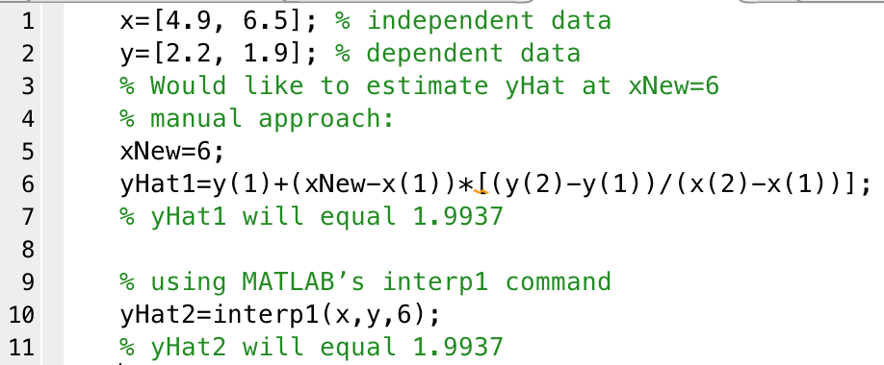
Linear interpolation
Use command interp1 to generate estimated/predicted y values based off of adjacent x-y data points.
Sample: yhat=interp1(x,y,xnew)

Slide 21
Acknowledgment
Based on handouts and lectures by Dr. Arash Mehboobin

